Slide 1


LIBRARY MANAGEMENT SYSTEM
GROUP-10
NAME | REGD.NO
ARUN KUMAR JOJO | 2201020248
SARASWATI SWAIN | 2201020258
M ABHISHEK | 2201020399
ARYAN SINGH | 2201020249
ABHILIPSA SWAIN | 2301030094

Slide 2


CONTENTS
1 | INTRODUCTION
2 | CONNECTING MYSQL TO C++
3 | METHODS USED
4 | BASIC TERMS
5 | FLOWCHART
6 | RESULT PREVIEW
7 | CONCLUSION

Slide 3

INTRODUCTION
A Library Management System (LMS) is software that organizes and tracks a library's catalog. It facilitates book receipt and issuance. In non-computerized systems, transactions are manually recorded in a register, requiring subsequent data entry. C++ can be leveraged for efficient development of a Library Management System.
OBJECTIVE:
Develop a C++ Library Management System (LMS) to automate cataloging, streamline book issuance and returns, manage user interactions efficiently, enable quick material retrieval through a robust search mechanism, maintain transaction logs, ensure data security, generate reports, integrate barcode technology, and create a scalable and maintainable system for improved library operations.

Slide 4
HOW TO CONNECT MYSQL TO C++?
Accessing MySQL Directories:-
Locate the MySQL installation directory on your system.
Identify the include, lib, and bin directories within the MySQL installation.
Project Setup in Dev-C++.
Open your C++ project in Dev-C++:-
Adding Include Directories:
Go to Project Options or Project Properties within Dev-C++.
Find the section for compiler or build settings.
Include MySQL Headers:-
Add the path to the MySQL include directory in the "Include Directories" or "Additional Include Directories" settings of your project in Dev-C++.
This step allows your C++ code to find and use MySQL headers (.h files) during compilation.
Linking to MySQL Libraries:
Locate the MySQL lib directory:-
Add the path to this directory in the "Library Directories" or "Additional Library Directories" settings of your project in Dev-C++.
Specify the MySQL library names (e.g., libmysql.dll on Windows or libmysql.so on Linux) as additional dependencies.

Slide 5

METHODS USED
For database interaction:
initializeConnection(): Initializes the MySQL connection.
addBook(): Adds a book to the database.
displayAvailableBooks(): Fetches and displays available books.
borrowBook(): Marks a book as borrowed.
returnBook(): Marks a borrowed book as returned.
deleteBook(): Deletes a book from the database.
For book record management:
insertRecord(): Creates a new book record.
searchRecord(): Searches for a book by title.
updateRecord(): Updates details of a book.
deleteRecord(): Deletes a book record.
showAllRecords(): Displays all book records.
main(): The main function to run the program.

Slide 6

BASIC TERMS
Library Management System (LMS): A system designed to manage the operations of a library, such as adding books, issuing them to users, and tracking returns.
C++: A powerful programming language used to create the Library Management System.
MySQL: A database management system used to store and retrieve data, such as book information and user details.
Database: A structured collection of data. In this case, the database stores information about the books (title, author, availability) in the library.
iostream: A standard C++ library that provides input and output functionalities, allowing the program to interact with the user (e.g., display messages and receive input).
Variables: Named storage locations in the computer's memory used to hold data. For example, title, author, and bookId are variables.
Functions: Blocks of code that perform specific tasks. Examples include addBook(), displayAvailableBooks(), borrowBook(), returnBook(), and deleteBook().
Input/Output:
Input: The process of receiving data from the user (e.g., using cin to get the book title).
Output: The process of displaying information to the user (e.g., using cout to show the list of available books).

Slide 7

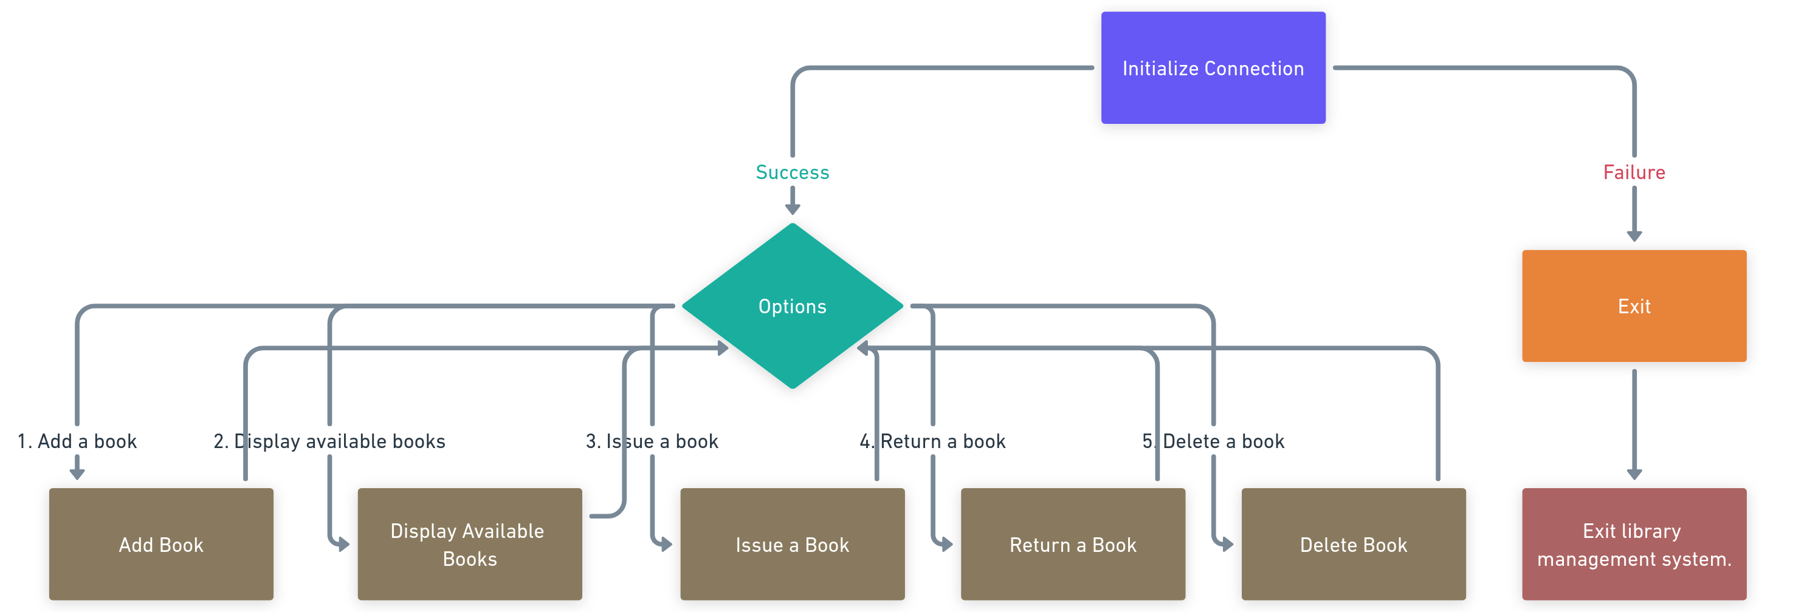
FLOWCHART

Slide 8
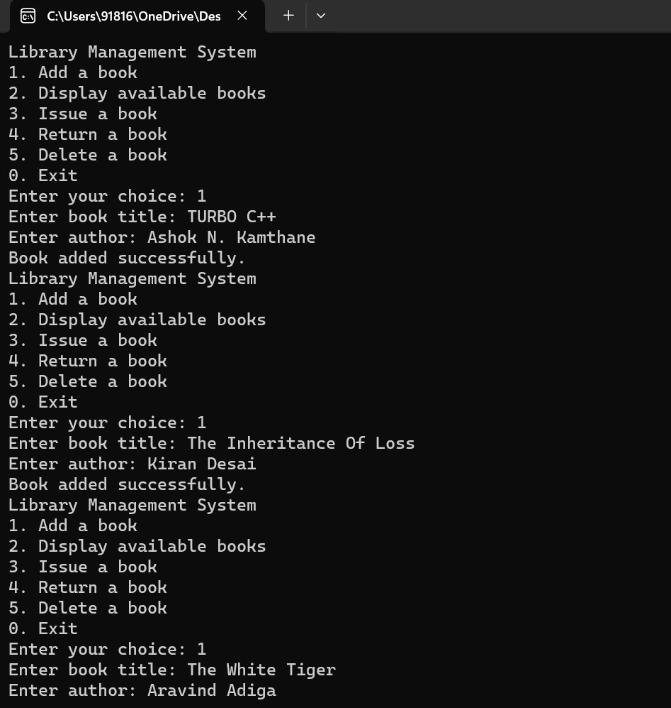
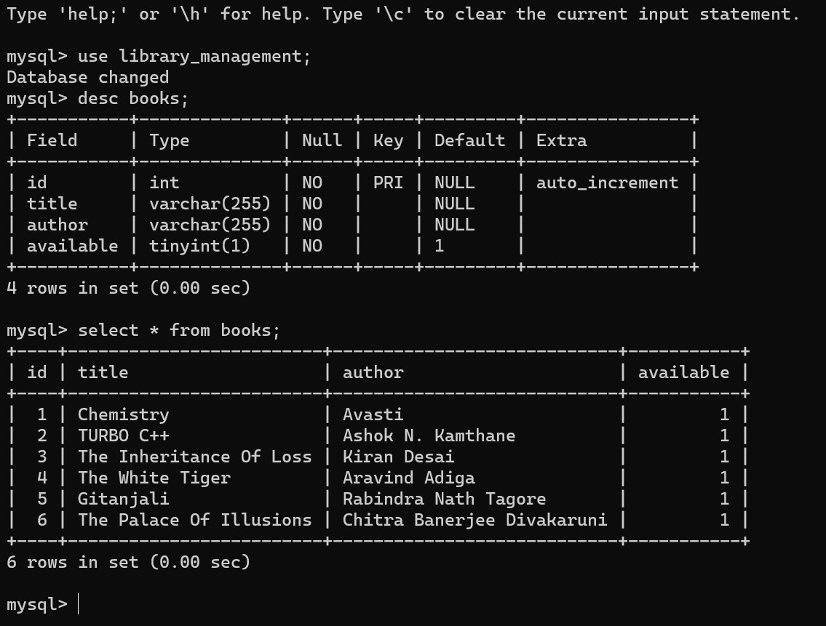
RESULT PREVIEW
SOURCE CODE OUTPUT
C++ CODE OUTPUT RESULT IN MYSQL

Slide 9
CONCLUSION
Library Management System is a powerful tool to manage the library. It helps to search for books, manage library staff, and keep track of library resources. It also helps to generate reports and keep track of library activities. It helps to manage the library inventory and keep track of library resources.
C++ is a powerful programming language and can be used to develop a library management system. It helps to create a user-friendly environment for library management. The library management system can be used to improve the efficiency of library operations and improve the user experience of library operations.
THANK YOU!

